Slide 1
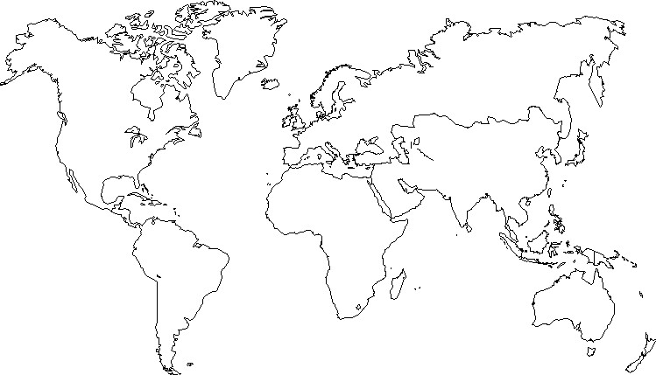
Greenland
Iceland
Russia
Canada
Northen Lands
UK
Center Europe
France
Kazakhstan
USA
Japan
Spain
Italy
China
Turkey
Central Asia
Mexico
North Africa
Arabia
India
Sahel
S.E.Asia
CAmerica
Ethiopia
Equateur
Congo
Indonesia
Brazil
Madagascar
South Africa
Independant Nation of Reunion Island
Argentina
Australia
New Zealand

